Slide 1

Back Bay Jewels
-Priyanka Senthil Kumar &
Samuel Dragomire

Slide 2

Background information and Business problem
Back Bay Jewels, is a jewelry and precious metal retailer
Business must keep track of every step of the jewelry-making process to stamp out any sources of imperfection or suspend trading with untrusted suppliers
For the sake of security and minimizing human interaction, with valuable items, the store will be online
Back Bay Jewels takes on the responsibility of quality checking the fineness of materials and recording them to meet the standards required for crafting jewelry
The company will offer replacement or repair service for damaged or defective pieces if the customer is registered in the e-commerce platform with their Customer ID

Slide 3
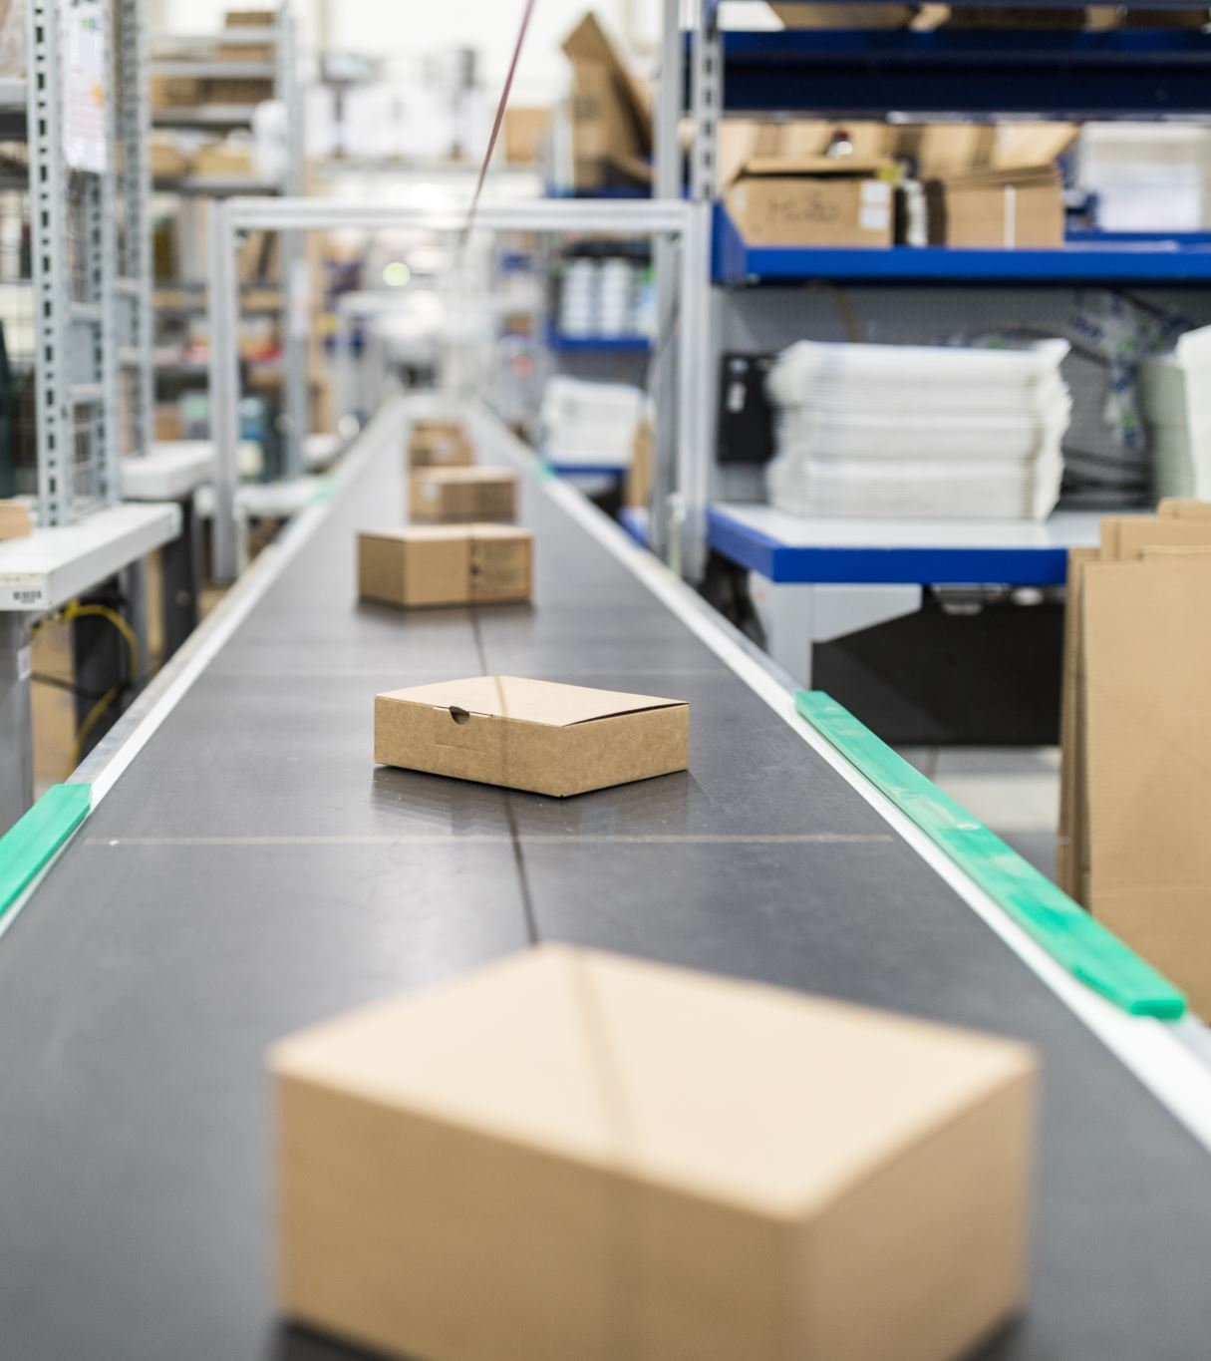
Business requirements
Business required a database management system to track raw materials purchased from suppliers, items stored in factory vaults, and customer purchases made from the online storefront
There should be a separate entity to aggregate the operations taken place in factory
There should be quality check recorder to verify the purchased items from suppliers meet the business standards and prevent continuing trade with disreputable suppliers
If any product is damaged while sending to a customer the business can have the item repaired at a reputable external jewelry showroom

Slide 4
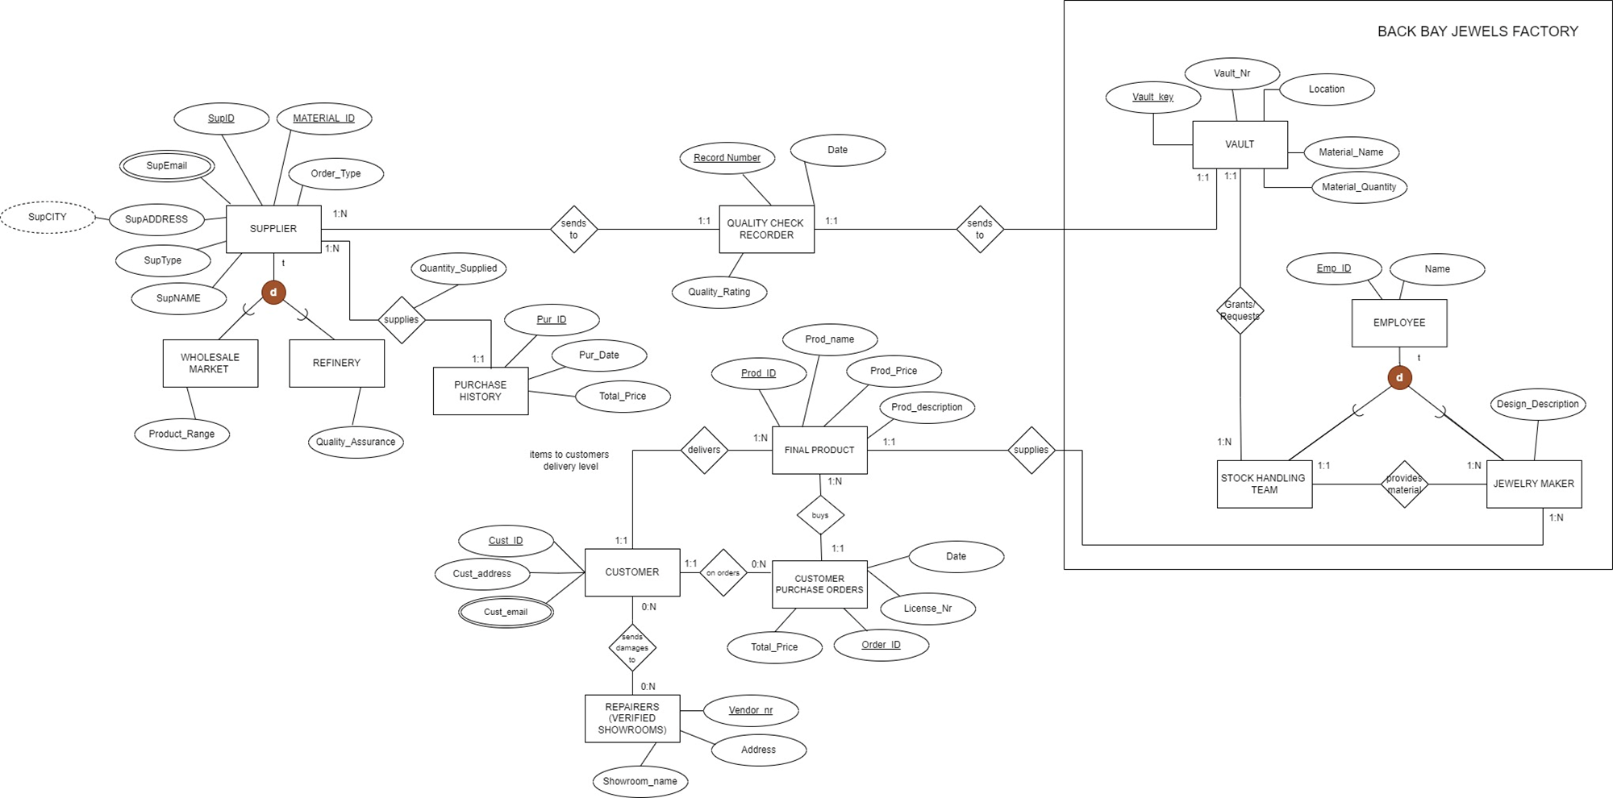
Conceptual data model (EER)

Slide 5
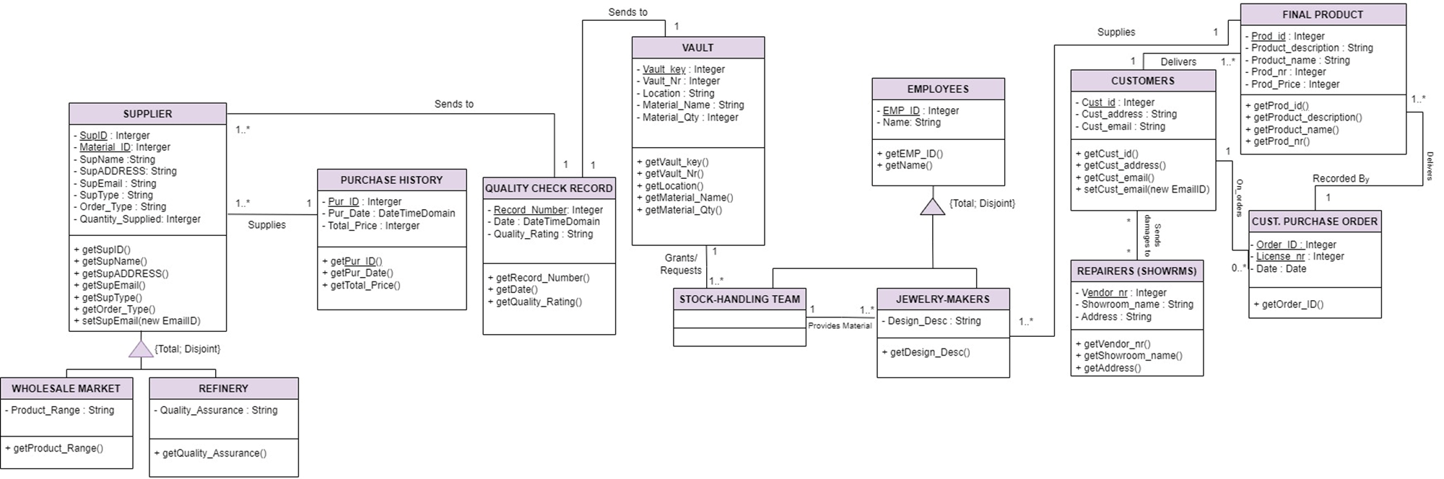
Conceptual data model (UML)

Slide 6
Relational model
EMPLOYEE (Emp_ID, Name)
STOCK_HANDLING_TEAM (Handeler_ID, Vault_Key)
Handeler_ID: Foreign key referring to the Emp_ID primary key of EMPLOYEE, NOT NULL
Vault_key: Foreign key referring to the Vault_key primary key of VAULT, NOT NULL
JEWELRY_MAKER (Maker_ID, Prod_ID, Design_Description)
Maker_ID: Foreign key referring to the Emp_ID primary key of EMPLOYEE, NOT NULL
Prod_ID: Foreign key referring to the Prod_ID primary key of FINAL PRODUCT, NOT NULL
FINAL_PRODUCT (Prod_ID, Prod_Name, Prod_Description, Prod_Description, Cust_ID, Order_ID)
Cust_ID: Foreign key referring to the Cust_ID of CUSTOMER, NOT NULL
Order_ID: Foreign key referring to the Order_ID of CUST_PURCHASE_ORDERS, NOT NULL
CUSTOMER (Cust_ID, Cust_address)
CUST_EMAIL (Cust_Email, Cust_ID)
Cust_ID: Foreign key referring to the Cust_ID of CUSTOMER, NOT NULL
REPAIRER (Vendor_Nr, Address, Showroom_name)
DAMAGES (Cust_ID, Vendor_Nr)
Vendor_Nr: Foreign key referring to the Vendor_Nr of REPAIRER, NOT NULL
Cust_ID: Foreign key referring to Cust_ID of CUSTOMER, NOT NULL
CUST_PURCHASE_ORDERS (Order_ID, Liscense_Nr, Cust_ID)
Cust_ID: Foreign key referring to the Cust_ID of CUSTOMER, NOT NULL
SUPPLIER (Sup_ID, Material_ID, Sup_Name, Sup_ADDRESS, Sup_Type, Order_Type, Quantity_Supplied, Record_Number, Pur_ID)
Record_Number: Foreign key refers to Record_Number of SUPPLIER relation, NOT NULL
Pur_ID: Foreign key refers to Pur_ID of PURCHASE HISTORY relation, NOT NULL
SUP-EMAIL (Sup_Email, Sup_ID)
Sup_ID: Foreign key refers to Sup_ID of SUPPLIER relation, NOT NULL
WHOLESALE_MARKET (Sup_ID, Material_ID, Product_Range)
REFINERY (Sup_ID, Material_ID, Quality_Assurance)
PURCHASE_HISTORY (Pur_ID, Pur_Date, Total_Price)
QUALITY_CHECK_RECORDER (Record_Number, Date, Quality_Rating)
FACTORY (F_Vault_Key, F_Emp_ID)
F_Vault_Key : Foreign key refers to Vault_Key of VAULT relation, NOT NULL
F_Emp_ID: Foreign key refers to Emp_ID of EMPLOYER relation, NOT NULL
VAULT(Vault_key, Vault_Nr, Location, Material_Name, Material_Quantity)

